Slide 1
Structure of the RS GCSE Course
Applied Ethics 1 (Mon 13th May)
7. Religion and human relationships
8. Religion and medical ethics
9. Religion, poverty and wealth
Applied Ethics 2 (Mon 13th May)
10. Religion, peace and justice
11. Religion and equality
12. Religion and the media
Short Course unit – in class
Full Course Unit - now
Philosophy 1 (exam Fri 14th June)
Beliefs about deity
Religion and spiritual experience
The end of life
Philosophy 2 (exam Fri 14th June)
4. Good and Evil
Religion, reason and revelation
Religion and science
You will answer questions
(a-e) on 2 of the 3 topics on each of the papers

Slide 2
The ‘Skedge’:
March 20th Religion and human relationships
March 27th Religion and medical ethics
(Easter break)
April 17th Religion, poverty and wealth
April 24th Revision session for three previous Applied Ethics sessions, including exam practise
May 1st Beliefs about deity
May 8th Religious and spiritual experience
May 13th Applied Ethics papers 1 & 2
May 15th The end of life
May 22nd Revision session for three previous Philosophy sessions, including exam practise
(Half term)
June 5th & 12th Open workshops for Philosophy Papers
June 14th Philosophy Papers 1 & 2

Slide 3
Religion and Human Relationships
The roles of men and women within a Christian family.
Christian teaching about marriage.
Christian responses to civil partnerships.
Christian beliefs about the ethics of divorce.
Christian beliefs about the ethics of remarriage.
Christian beliefs about sexual relationships.
Christian beliefs about contraception.

Slide 4
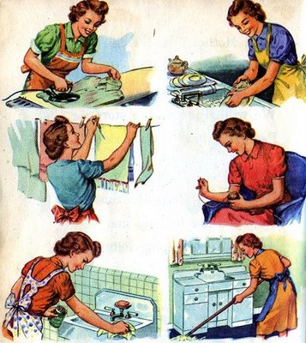
Roles of men and women within a Christian family
Traditional Viewpoint
Role of women: have children, bring them up, run Christian home for the family. Must submit to husband, accepting his overall authority.
Role of men: provide for physical needs of families by bringing in wage. Should lead family in religious matters, including worship in home. Should love their wives as much as they love themselves and take the lead in church life
Modern Viewpoint
Most Christian churches now accept that men and women are equal
These churches include Anglican, Baptist & Methodist.
Churches show this through female vicars.

Slide 5
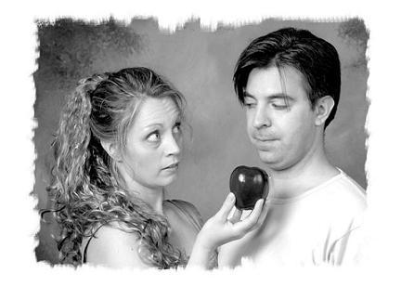
Scripture support for traditional view
Gen 2
God made male then female
Only once Adam finished naming all the animals did he tell God he needed a companion.
St. Paul (1 Cor)
‘As in all churches of the saints, women should be silent in the churches. For they are not permitted to speak, but should be subordinate as the law says. If there is anything they desire to know, let them ask their husbands at home. For it is shameful for a woman to speak in church. (14:34f)
1 Peter
‘Wives in the same way, accept the authority of your husbands... The holy women who hoped in God used to adorn themselves by accepting the authority of their husbands. Thus Sarah obeyed Abraham and called him Lord.’ (3:1-7)
‘Husbands in the same way show consideration for your wives in your life together, paying honour to the woman as the weaker sex’ (3:8)
God created Eve as Adam’s ‘helpmate’
Eve tempted Adam! (The Fall)

Slide 6
Scripture support for traditional view
Wives, submit to your husbands as to the Lord. For the husband is the head of the wife as Christ is the head of the Church... Husbands, love your wives just as Christ love the church... In the same way husbands ought to love their wives as their own bodies. He who loves his wife loves himself... Each one of your must love his wife as he loves himself and the wife must respect her husband
(Colossians 3:18f and Ephesians 5:25.28)
A woman should learn in quietness and full submission. I do not permit a woman to teach or have authority over a man; she must be silent. For Adam was formed first then Eve. And Adam was not the one deceived; it was woman who was deceived and became a sinner
(1 Timothy 2:11-14)

Slide 7
Scripture support for modern view
Treated men and women as equals
‘God created man in his image…male and female he created them’
Preached in the Court of Women in the Jerusalem temple
Treated a Samaritan woman as equal
Had women followers who stayed with him at the Cross and ministered to him. No women in 12 disciples but many women who travelled with him and supported him in many ways.
First appeared to women after his resurrection before appearing to his male disciples

Slide 8
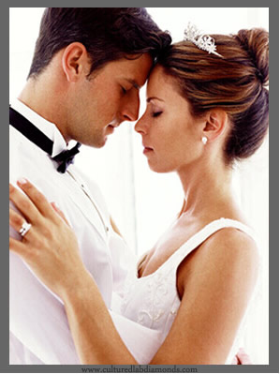
Christian teaching about marriage
1
In the beginning, marriage was designed and created by God
2
Marriage is the solemn agreement between two people that is made in presence of God
3
Marriage is the only suitable relationship in which sexual intercourse can take place
4
5
6
Marriage is the ideal relationship in which to have and bring up children
Marriage is intended to be a permanent relationship
Within marriage, the couple are intended by God to be sexually faithful to each other

Slide 9
Purpose of Marriage Marriage carried out ‘in the sight of God’
Purpose 1
To provide each other with mutual help and support in both the good and bad times together
Purpose 2
To have sexual intercourse in a secure loving environment where both mean and woman can feel equally loved
Purpose 3
To have children and bring them up in a Christian home.
Intended to be life long partnership
Only ended by death of a partner
Rings exchanged as visible sign of vows taken
Perfect unending circle, symbolises that love which it is hoped will last and grow through life into eternity.

Slide 10
Vows made during the wedding ceremony (cover whole range of human experience)
I (name) take you (name) to be my husband/wife
To have and to hold from this day forward
For richer, for poorer
To love and to cherish
According to God’s holy Law and in the presence of God I make this vow
Till death us do part
In sickness and in health
For better, for worst

Slide 11
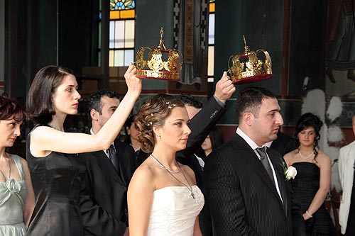
Variations on marriage ceremony
Roman Catholic
Marriage is a ‘sacrament’.
A sacrament is a Christian service that is a special way in which God passes on his blessing to the couple.
Outward sign of an inward blessing
Catholics believe, in marriage each partner becomes a channel of God’s blessing to the other. Explains why service for 2 Catholics ends with a Nuptial Mass
Orthodox Church
Service is called ‘the crowning’.
Crowns are placed on the heads of the man and woman. In this way the two of them receive the power of the Holy Spirit to love each other and any of the children they may have.
The crowns indicated both joy and self-sacrifice.

Slide 12
Christian responses to civil partnerships
On December 5th 2005 civil partnerships became legal in the UK.
It is a formal ceremony in which they can make promises to each other and which gives them the same legal status as married heterosexual couples.
Civil partnership ceremonies, by law, do not have any religious content to them.
Many Christians believe that the Bible is quite clear in saying homosexual activity is a sin.

Slide 13
Quotes from Scripture
In Leviticus it says: ‘Do not lie with a man as one lies with a woman; that is detestable’
Over the years the attitude of the Christian Church has changed and many Christians would say that while homosexual feelings are acceptable because the person can do nothing about them nevertheless they must live celibate lives because homosexual activity is a sin.
This leads on from the view sex is for when people are married and wanting to raise children.

Slide 14
Divorce and the Law
The number of divorces is increasing
26,000pa in 1960 vs.170,000pa today
Date | Status
Pre 1857 | Could only be obtained by an expensive act of Parliament. Ecclesiastical courts could grant legal separations, but these did not permit either partner to remarry.
1857 | Possible in England and Wales for both men and women to obtain a divorce. Men - grounds of adultery alone Woman - had to prove adultery /cruelty of her husband
1923 | Men and women could obtain divorce on same grounds
1937 | Desertion, cruelty and insanity added to adultery as grounds for divorce
1969 | Unnecessary to prove that someone was to blame for the break down of a marriage. Divorce allowed if ‘marriage had irretrievably broken down’ Adultery, cruelty and desertion could be used to prove this had happened

Slide 15
Divorce and the Bible
Moses allowed the Jews to divorce because the people failed to live up to God’s ideal of marriage.
Was always a compromise not part of God’s original plan
OLD
TESTAMENT
Easy for a man to obtain a divorce but only allowed if she has been unfaithful to him (Mt)
In Mark’s Gospel – no grounds for divorce. ‘Whoever divorces his wife and marries another commits adultery against her; and if she divorces her husband and marries another she commits adultery (Mk 10:11f) which was forbidden by 10 C’s (Ex 20:14)
A Jewish woman could not obtain a divorce under any circumstance
NEW TESTAMENT JESUS
A man must not divorce his wife in any circumstances.
A wife should not leave her husband but if she did then she was to remain unmarried or return to her husaband
NEW TESTAMENT PAUL

Slide 16
Divorce and the Church
Church of England
Accepts divorce as social necessity but will not remarry divorced people unless vicar agrees it.
Encourages civil ceremony then blessing in church after
Free Churches
I.e. Baptist, Methodist
Allows divorced people to remarry in Church.
Individual minsters can refuse if it conflicts with their own views on marriage and divorce
Roman Catholic
Marriage is a sacrament that cannot be dissolved.
Suggests separation rather than divorce or annulment (would mean the marriage never took place.)
Granted annulment if
* Can be shown couple did not fully understand what they were doing when getting married
* One of the partners did not give their full assent to the marriage
* One of the partners did not intent to have children at any time and the other person did not realise this

Slide 17
Beliefs about sexual relationships
UK – illegal to have sex with anyone under 16
20% of men & women are virgins when they marry
50%+ lose their virginity before 18th birthday
PRE-MARITAL SEX Two people not married.
Can be between a couple in a steady relationship.
Can be casula sex between 2 people who hardly know each other (I.e. 1 night stand)
EXTRA-MARITAL SEX One or both of the people is married but not to each other.
The marriage(s) may have broken down but the Church doesn’t see any difference.
Some Christians see sex outside the marriage as wrong and a sin. Sex should cement a marriage & bless people with children.
Jesus frequently spoke out against fornication (pre) and adultery (extra)
Christians believe sex is a God given way for two people to express their love within marriage
MOST CHRISTIANS REGARD SEX AS ONE OF GOD’S GREATEST GIFTS TO THEM AND SO ONE TO BE ENJOYED
SEX IS FOR CREATING NEW LIFE! CofE LOOKS TO IT AS AN EXPRESSION OF LOVE
CHRISTIANS ARE NOT AGAINST SEX! THEY THINK THERE IS A TIME AND A PLACE FOR SEX AND THAT IS IN THE CONTEXT OF A LOVING MARRIAGE.
CHRISTIANITY SAYS NO?

Slide 18
Beliefs about co-habitation
For many Christians co-habitation (living together outside of marriage) is not accepted.
God intended people to marry but not to cohabit as this encourages sexual relations outside of marriage.
The 7th commandment ‘you shall not commit adultery’ – interpreted as wrong to have a sexual relationship with anyone to whom you are not married.

Slide 19
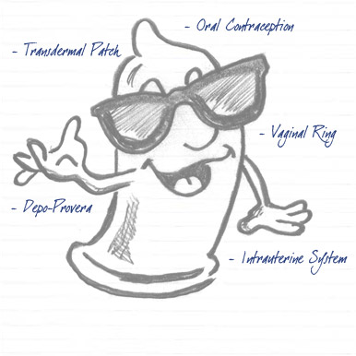
Why might people be having sex outside the marriage?
Effective contraception is now freely available
If contraception fails, abortion could be available. With the ‘morning after’ pill conception can be prevented up to 6 days after sexual intercourse. No one has to go through a pregnancy if they don’t want to.
Few people expect their partners to be virgins when they marry them
Few people accept the teaching of the Church which has always been against sex before and outside of the marriage.
Sex at any price?
Numbers of people reporting sexual transmitted diseases are rising steeply
AIDS is spreading
More unwanted and unplanned babies are being born
Thousands of marriages are breaking up each year due to one or both partners being unfaithful

Slide 20
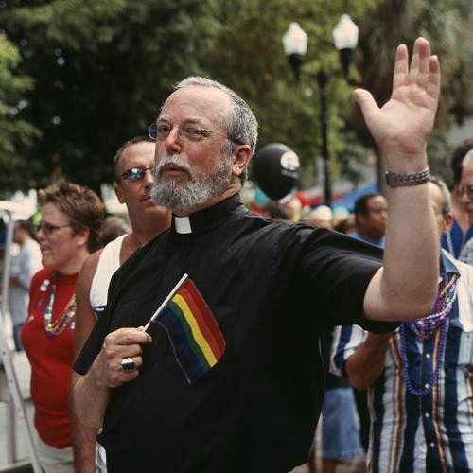
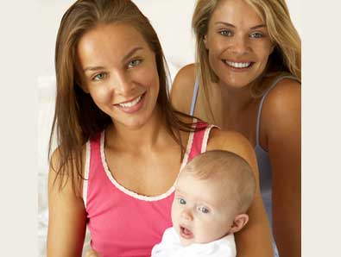
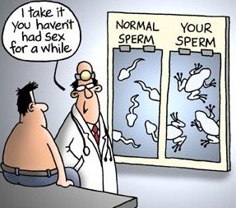
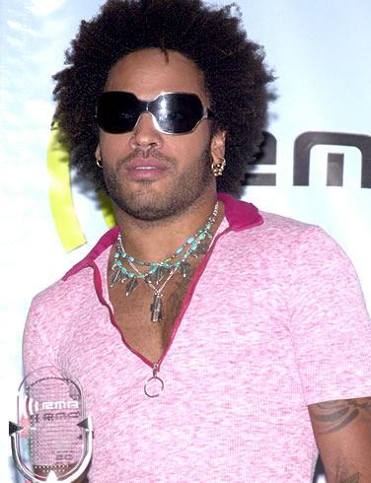
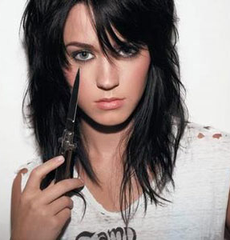
Celibacy - A way out???
Excluding marriage and sex
Associated with Roman Catholic Church
Paul was unmarried and commended the celibate state for those who wished to devote themselves fully to the service of God.
‘I wish that all were as I myself am. But each has a particular gift from God, one having one kind and another a different kind’ (1 Cor 7:6)
1139 – Catholic Church demanded all priests be celibate (only church to do so)
There is a call for this to be changed – especially as the number of men joining the clergy is decreasing.
Pope Paul II – the rule stays!!
‘Do not deprive one another except perhaps by agreement for a set time, to devote yourselves to prayer and the come together again, so that Satan may not tempt you because of your lack of self control...’ (1 Cor 7:5)
A divisive issue - Homosexuality
Many Roman Catholics are strongly opposed to homosexuality
Some parts of the Anglican Church, especially African, teaches homosexuality is a sin.
This is a divisive issue because there are many Christians who are homosexual, including many priests. These Christians refer to ‘love thy neighbour’ to highlight how they should be treated.

Slide 21
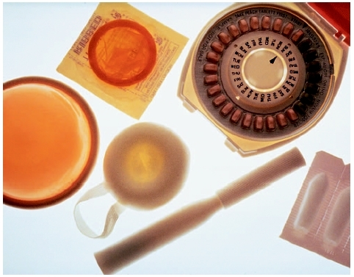
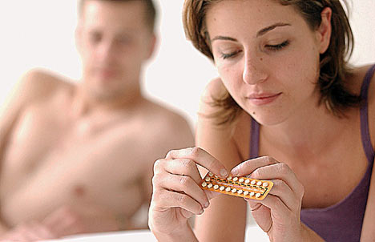
RC beliefs about contraception
Only denomination that is strongly opposed to contraception!
Only form which is acceptable is the ‘rhythm method’
‘...each and every marriage [sexual] act must remain open to the transmission of life’ (Pope Paul VI)
Humanae Vitae (On the Regulation of Life) 1968
Outlawed the pill, condom, sterilisation!!
Do Catholics have to get pregnant everytime they have sex?
Rhythm method
Abstinence
God set purpose of married life to be making a family (I.e. Having a child)
RCs in USA and UK upset by this. Survey suggested 80% ignored the teaching of the church and use contraception if they do not want to have a baby.

Slide 22
Church of England
All forms of contraception ok if acceptable to both partners!
It allows a couple to decide when they would like to have a baby
Allows for responsible family planning.

